Slide 1
Predicting SF city employee salaries
Alma Caus
Intro to Data Science
Winter 2016

Slide 2
Problem & Hypothesis
Problem
Predict the salary (base pay) of city of San Francisco employees
Hypothesis
Each of the features will have significant prediction power for predicting the Base Pay

Slide 3
Data Description
Obtained data from Kaggle website, in “datasets” section.
Data came in CSV format with 148,654 rows and the following 13 columns: ID, EmployeeName, JobTitle, BasePay, OvertimePay, OtherPay, Benefits, TotalPay, TotalPayBenefits, Year, Notes, Agency, and Status.
Notes:
Explain what data is in each of these columns, if its not obvious by the name of the column

Slide 4
Preprocessing
Deleted Status and Notes columns because of too many missing values
Deleted Agency, as it had the same value for all rows
Deleted ID and Employee Name since they are useless for modeling
Converted the “Not Provided” values that were present in four of the columns into NaNs
Took out all rows that did not have values for BasePay because BasePay is the target feature and should not be imputed
Notes:
Imputation only goes so far and isn’t super accurate. That is why I deleted the columns with too many missing values

Slide 5
Preprocessing
Separated BasePay and converted from Pandas DataFrame it into NumPy array
Created new feature JobType. This feature bins JobTitles into broader job types. Dropped JobTitles after JobType creation.
Created dummy (indicator) features for n-1 levels of both JobType and Year, as they are categorical features
Notes:
Created the new job type feature so that the type of job could be used as features in the model. Job titles could not be used because I would’ve had to create way too many dummy variables. I tried to create all of the variables for job title and it crashed my computer. Creating all of those dummy variables would have also made the algorithms fit very slowly.
Need to create N-1 dummy variables because if N dummy variables are created I fall into the ”dummy variable trap”. --- I explained this concept to you a few times already, google “dummy variable trap” if you need a refresher.

Slide 6
Preprocessing
Converted DataFrame into NumPy array
Performed mean imputation to fill-in all NaN values
Normalized all of the numeric features
Split dataset into train and test sets
Notes:
Features need to be normalized to help algorithms run faster and to make sure equal weight is given to each feature. Features with very high values (say 2,000) could be given much more weight in the model than features with small values (say 2.5), this is why we must normalize.

Slide 7
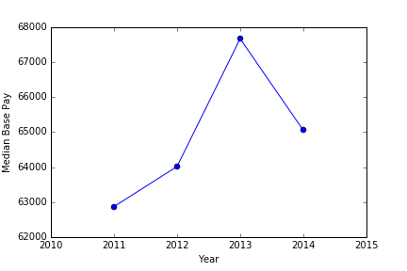
Exploratory Analysis
Median BasePay by Year shows how base pay changes over the years
Notes:
Appears that overall base pay has increased until 2013, then began decreasing.

Slide 8
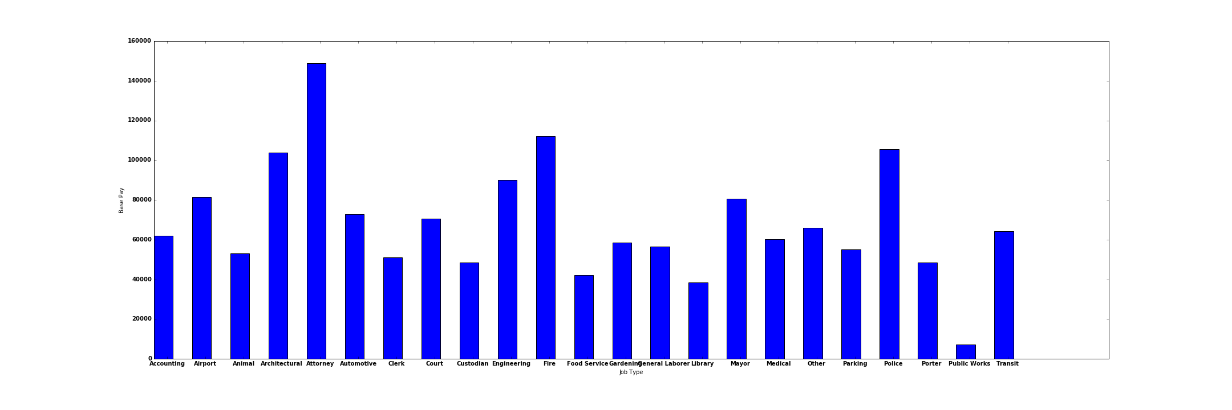
Exploratory Analysis
Median BasePay by JobType shows what base pay different jobs types obtain
Top paying job types included Attorney, Fire, Architectural, and Police.

Slide 9
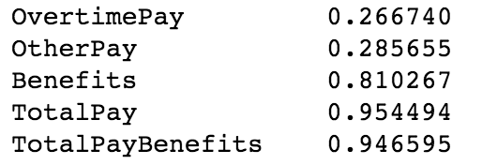
Exploratory Analysis
Correlation between target feature and quantitative predictor features shows the relationship each feature has with target feature
Notes:
Appears that OvertimePay and OtherPay are not very correlated with BasePay, while Benefits, TotalPay, and TotalPayBenefits have a high positive correlation with BasePay.

Slide 10
Algorithm Selection
Regularized Linear Regression (both L1 & L2) and Random Forest Regression were the selected algorithms
Regularized Linear Regression is a good algorithm for capturing linear relationships, while Random Forest Regression captures both nonlinear and linear relationships
Regularized Linear Regression is an explainable model while Random Forest Regression is more of a black-box model
Strategy – Try Regularized Linear Regression first. If it does not produce a good model try Random Forest Regression
Notes:
L1 is “lasso regression”, L2 is “ridge regression”. The regression equation produce by linear regression is easy to understand and can be used to draw further inferences about the relationships between the predictor features and the target feature. Random Forests are known to be better at producing accurate predictions, probably a result of them being ensemble algorithms (produces multiple models).

Slide 11
Feature Selection
Both machine learning algorithms used automatically chose which features should be included in the model
Regularized Linear Regression chooses very small coefficients (close to 0) for useless features. This is a form of feature selection
Random Forest Regression only uses features that increase each of the tree’s “purity”, usually will not use any useless features.
Notes:
By useless features, I mean features that do NOT have a significant relationship with the target feature. The only way that Random Forests should ever choose to use useless features are if we tell (force) the Random Forest to create many nodes.

Slide 12
Parameter Tuning
10-fold Cross-validation was used for parameter tuning
Parameter value that achieved the highest cross-validation explained variance score is chosen as the value to use for the parameter
Both the L1 and L2 versions of Regularized Linear Regression were tried
Random Forest Regression was tried using 5 trees, 10 trees, and 20 trees
Notes:
10-fold cross-validation is industry standard.
L1 and L2 are different types of regularization --- your class slides on regression talk about them
Google “explained variance” score to gain more of an understanding on exactly what it means

Slide 13
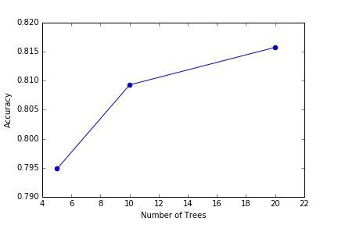
Parameter Tuning
Notes:
Graph showing explained variance vs. number of trees used in Random Forest Regression.
It may be best to use even more than 20 trees but would become more computationally expensive (the more trees you use, the longer it takes to fit the model).

Slide 14
Model Comparisons
Both the L1 and L2 versions of Regularized Linear Regression had only 41% cross-validation explained variance score
Random Forest Regression showed much better results with 5 trees having 79% explained variance, 10 trees having 81% explained variance, and 20 trees having 82% explained variance
Random Forest Regression with 20 trees was chosen as the final model as it had the highest cross-validation explained variance
Final model produced 82% explained variance on the test set
Notes:
41% explained variance is very bad.

Slide 15
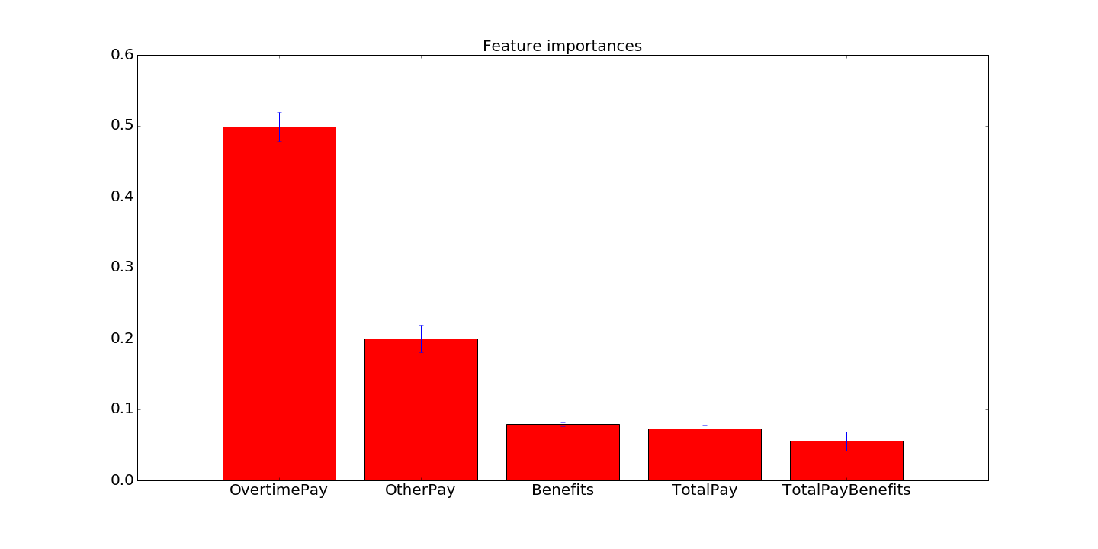
Feature Importance
Top 5 most important features
Notes:
A feature being “important” means that it increased the “purity” of most of the trees in the forest substantially
The importance of a feature is computed as the (normalized) total reduction of the criterion brought by that feature. It is also known as the Gini importance

Slide 16
Next Steps
Do further parameter tuning - try tuning max depth, max features, etc.
Try more algorithms, namely another ensemble like Gradient Boosted Regression Trees or even try using multiple different algorithms and averaging their predictions
See if model works well for predicting employee base salary is other cities
Notes:
Max depth = maximum depth of each tree (in terms of nodes)
Max features = maximum amount of features used in each tree

Slide 17
Conclusion
Explored and preprocessed the data
Performed feature and model selection by trying different algorithms and different parameters, using cross-validation score to compare
Chose a final model that showed to have good prediction performance on the test set
Final Model can be used to accurately predict future SF city employee salaries

